Slide 1

Disentangling conflict and collaboration between users a Reddit Place experiment
Pierre-Antoine Desplaces
PhD : Jérémie Rappaz
Semester project at LSIR

Slide 2



Motivation
Disagreement
Conflict
Agreement
Collaboration
Interaction quality spectrum

Slide 3

Previous work
User-user collaboration detection¹
Inter-community conflict prediction²
Define a scale from conflict to collaboration in user interactions

Slide 4
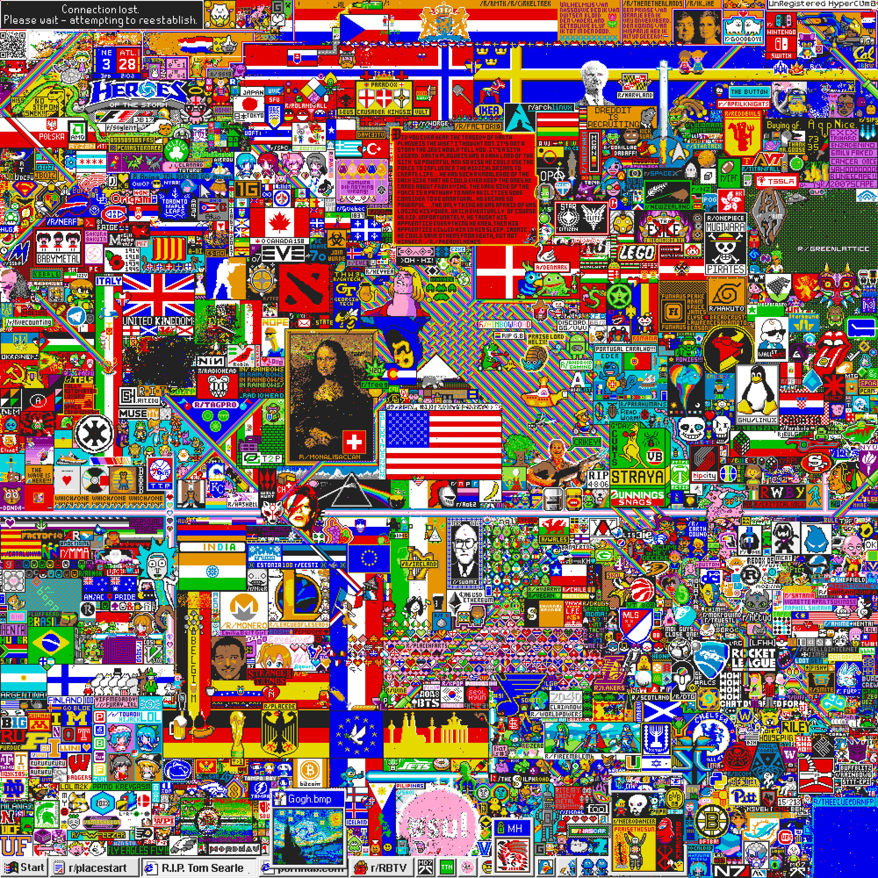
Reddit Place
72 hours
1000x1000 canvas
16 colors
16.5M clicks
1.2M users

Slide 5


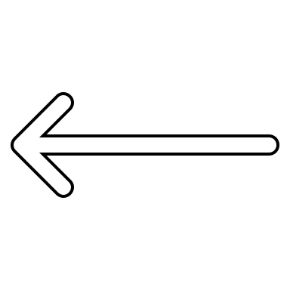

Local Agreement
$LA= \frac{\text{\# }\text{of} \text{tiles} \text{with} \text{same} \text{color}}{\text{\# }\text{of} \text{occupied} \text{tiles}}−0.5$
Example : here it would be $\frac{2}{7}$
Previous agreement = average local agreement of tiles around before click

Slide 6


Local Agreement in Place

Slide 7
Feature-based models
User features for each click :
Past average local agreement
Previous agreement on next tile
Average number of collaborators
Median distance between clicks
Average time between clicks
Number of clicks

Slide 8
Feature-based models
User features for each click :
Past average local agreement
Previous agreement on next tile
Average number of collaborators
Median distance between clicks
Average time between clicks
Number of clicks
 | Linear Regression | Neural Network | Baseline
Test RMSE | 0.28742 | 0.28701 | 0.31439

Slide 9
Feature-based models
User features for each click :
Past average local agreement
Previous agreement on next tile
Average number of collaborators
Median distance between clicks
Average time between clicks
Number of clicks
 | Coeffcients
 | 0.6296
 | 0.3440
 | - 0.0223
 | - 0.0189
 | 0.0623
 | 0.0319
 | Linear Regression | Neural Network | Baseline
Test RMSE | 0.28742 | 0.28701 | 0.31439

Slide 10
Embedding-based models
Only one scalar per user
→ converges to average agreement

Slide 11
Embedding-based models
Only one scalar per user
→ converges to average agreement
Vector of size 10 for each user
Dot product of current and previous user embeddings
Concatenate them and feed it to a neural net

Slide 12

Embedding-based models
Only one scalar per user
→ converges to average agreement
Vector of size 10 for each user
Dot product of current and previous user embeddings → RMSE 0.42435
Concatenate them and feed it to a neural net → RMSE 0.33172

Slide 13
Embedding-based models
Only one scalar per user
→ converges to average agreement
Vector of size 10 for each user
Dot product of current and previous user embeddings → RMSE 0.42435
Concatenate them and feed it to a neural net → RMSE 0.33172
Hypothesis : user-user interactions are too sparse to capture something meaningful

Slide 14
Broken windows theory
« The broken windows theory is a criminological theory that visible signs of crime, anti-social behavior and civil disorder create an urban environment that encourages further crime and disorder. »
Evolution of local agreement measure by zones
Notes:
The theory was introduced in a 1982 article by social scientists James Q. Wilson and George L. Kelling.^{[1]} It was further popularized in the 1990s by New York City police commissioner William Bratton and Mayor Rudy Giuliani, whose policing policies were influenced by the theory.

Slide 15
Environment-user model
Instead of user-user, look at interactions between users and their environment :
Split canvas into 20x20 grid of 400 zones of size 50x50
Each zone is embedded into vector of size 10
Output is the dot product of the zone and user vectors

Slide 16
Environment-user model
Instead of user-user, look at interactions between users and their environment :
Split canvas into 20x20 grid of 400 zones of size 50x50
Each zone is embedded into vector of size 10
Output is the dot product of the zone and user vectors
RMSE = 0.32442

Slide 17
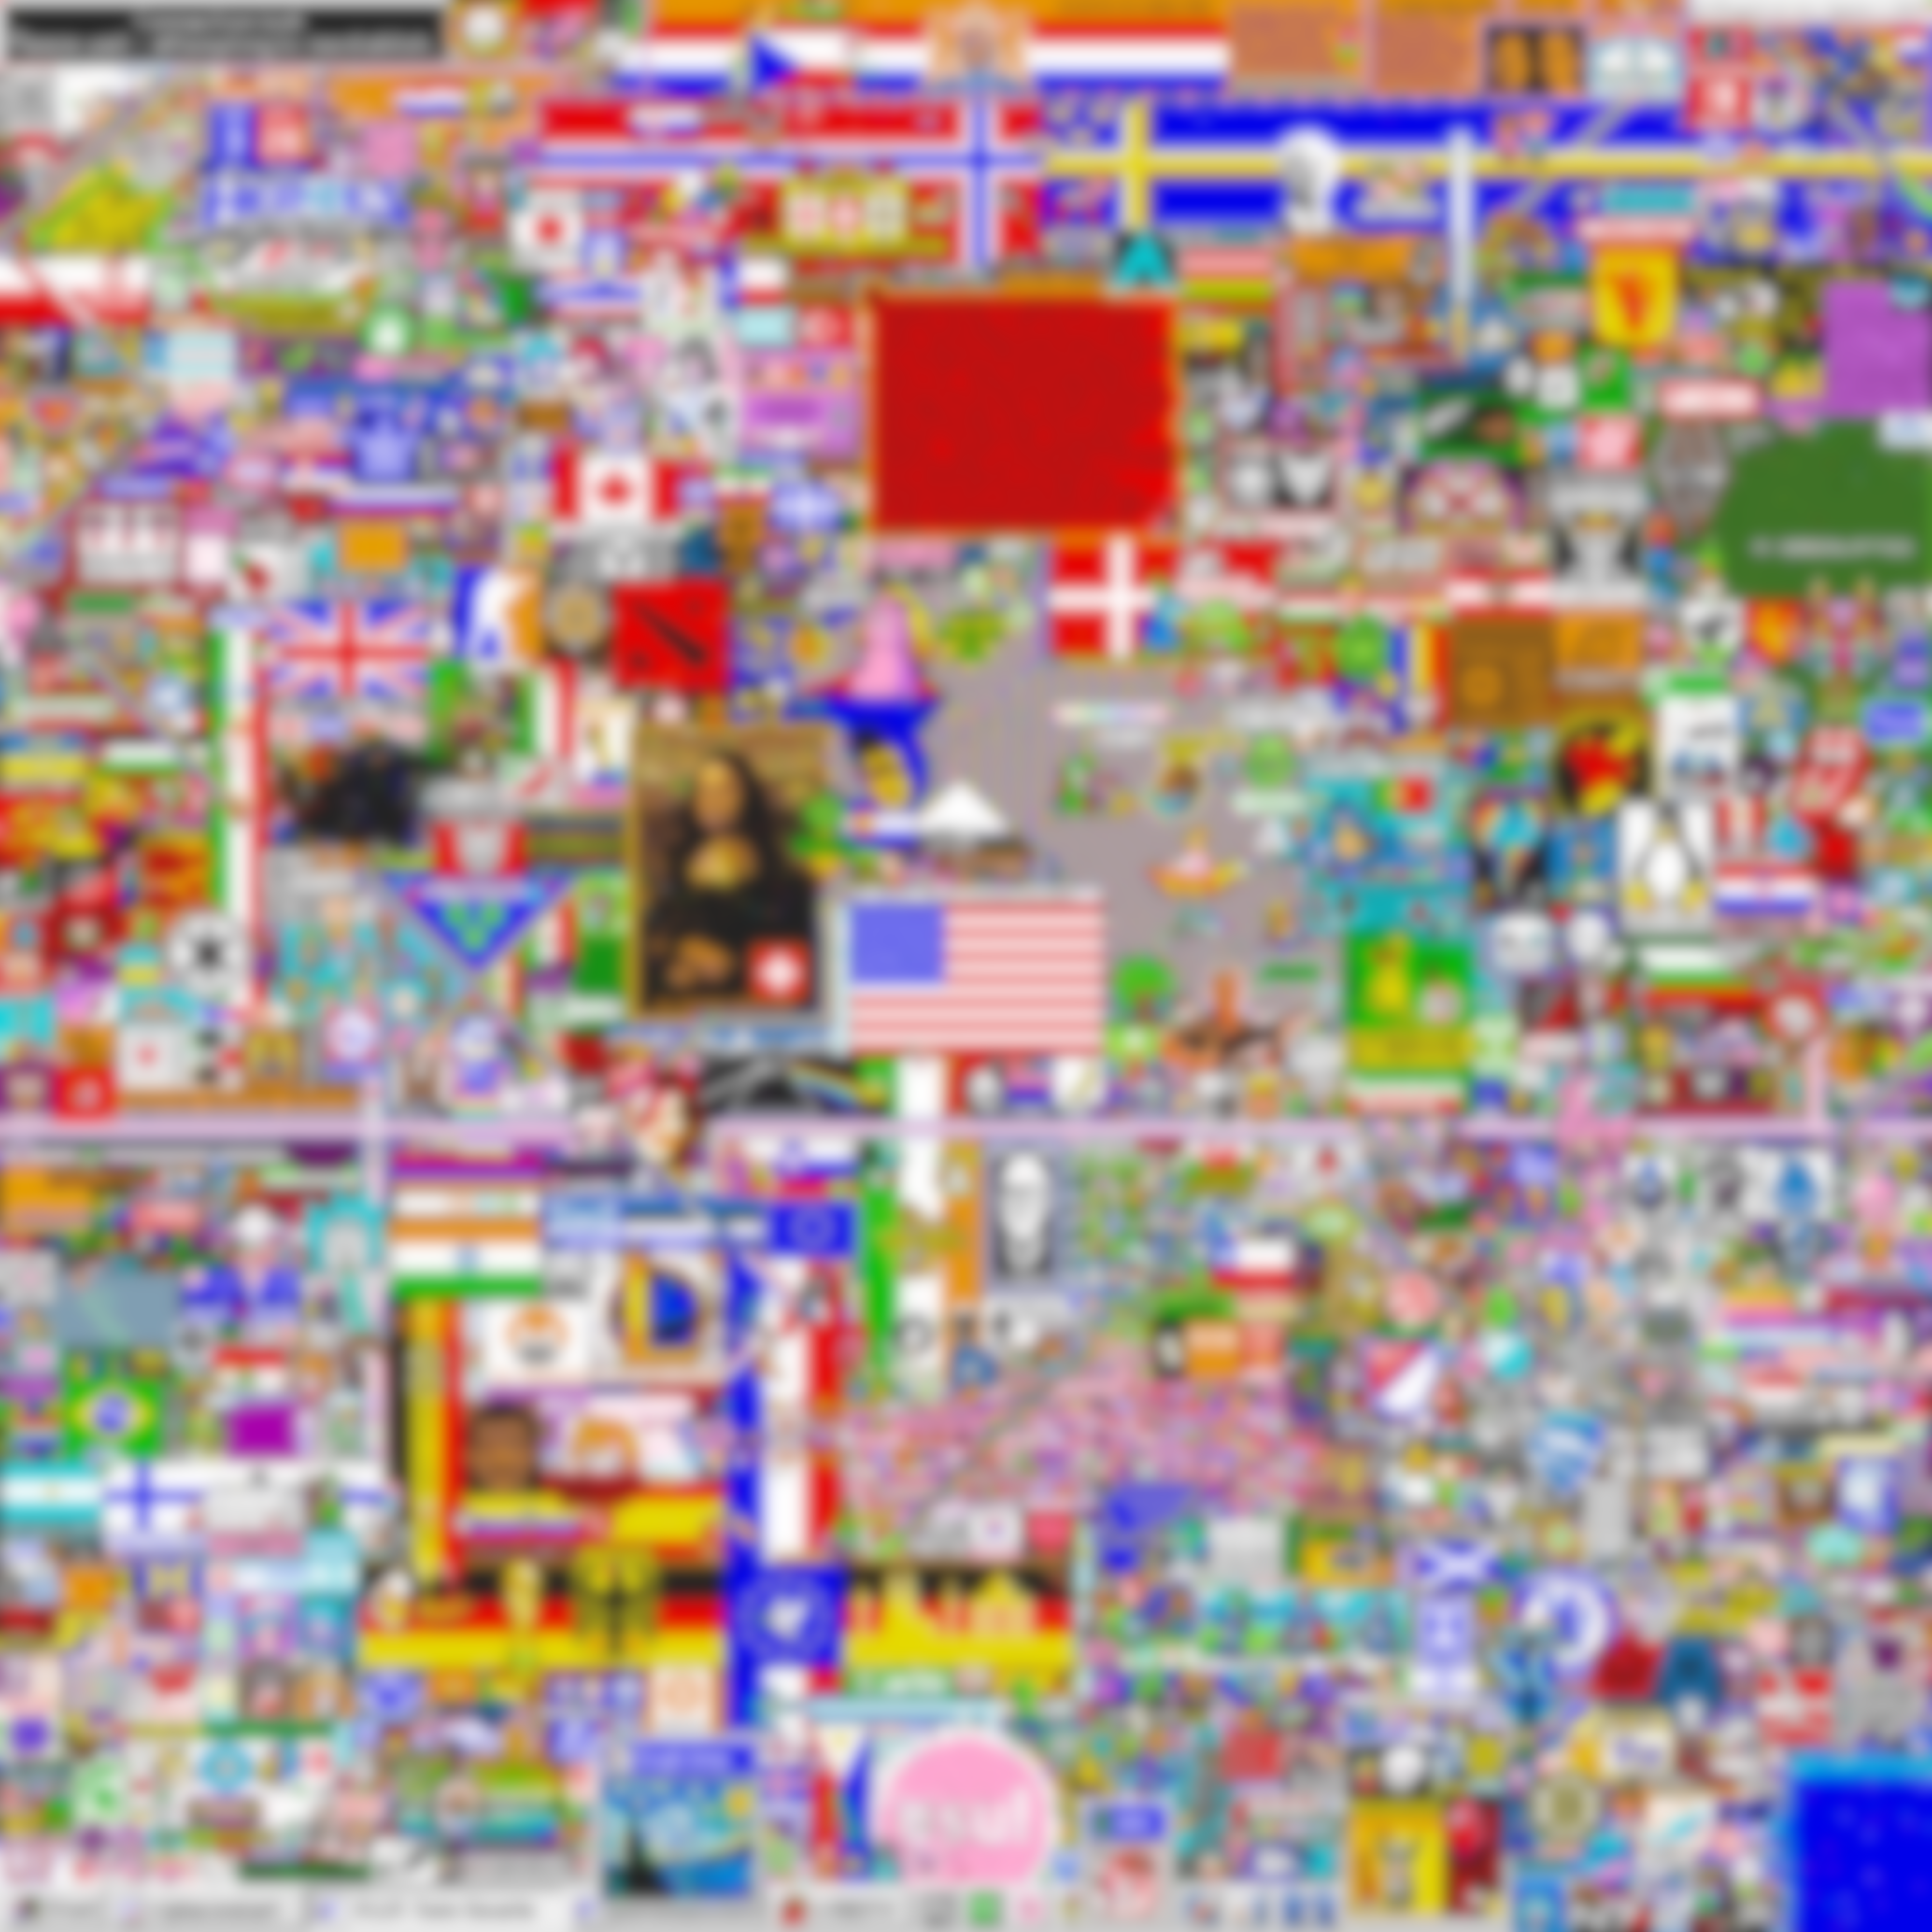
Specific case study
The USA flag in the center :
616’355 clicks
152’025 users
4 zones cover most of it
Compute dot products of every user vector with the vector of these zones and sum them
Rank those scores

Slide 18
Ranking user embeddings
Most collaborative 10’000 users
Least collaborative 10’000 users

Slide 19
Conclusion and further work
Propose a metric to measure the level of collaboration/conflict of user interactions
Evaluate different models on predicting this metric

Slide 20
Conclusion and further work
Propose a metric to measure the level of collaboration/conflict of user interactions
Evaluate different models on predicting this metric
Refine the metric
Could improve range of locality
Artwork level instead of click level
Take artwork complexity into account
Generalize to different datasets

